Slide 1
Chapter 3 Retailing in Electronic Commerce: Products and Services

Slide 2
LEARNING OBJECTIVES
Describe electronic retailing (e-tailing) and its characteristics.
Define and describe the primary
e-tailing business models.
Describe how online travel and tourism services operate and their impact on the industry.
Discuss the online employment market, including its participants, benefits, and limitations.
Describe online real estate services.
Discuss online stock-trading services.

Slide 3
LEARNING OBJECTIVES
Discuss cyberbanking and online personal finance.
Describe on-demand delivery of groceries and similar products/services.
Describe the delivery of digital products and online entertainment.
Discuss various online consumer aids, including comparison-shopping aids.
Describe disintermediation and other B2C strategic issues.

Slide 4
INTERNET MARKETING AND ELECTRONIC RETAILING
electronic retailing (e-tailing)
Retailing conducted online, over the Internet.
e-tailers
Retailers who sell over the Internet.
SIZE AND GROWTH OF THE B2C MARKET
Growing exponentially or slowing down?

Slide 5
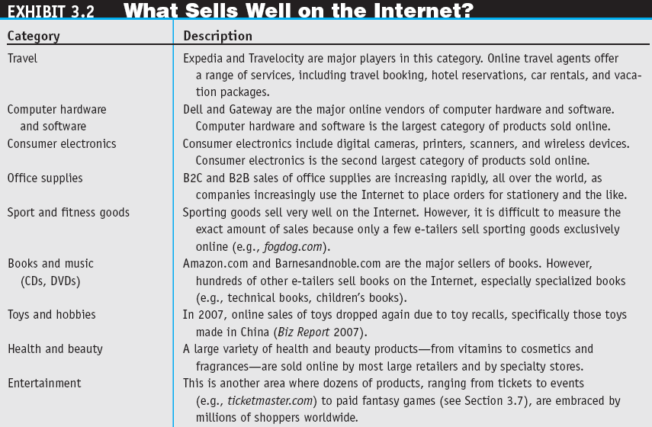

Slide 6
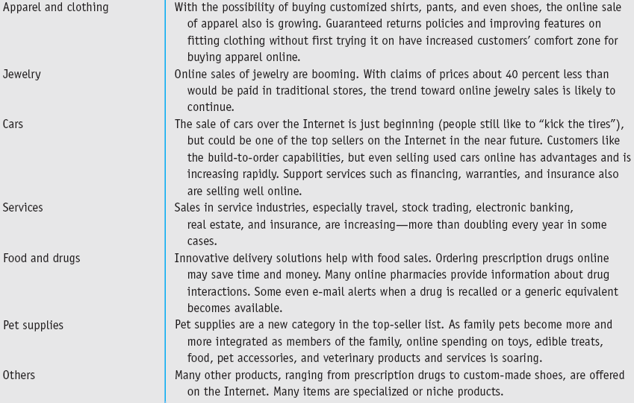

Slide 7
INTERNET MARKETING AND ELECTRONIC RETAILING
7 Product Characteristics – facilitate higher sales volume by e-tailers
High brand recognition (Nike, Sony, Dell etc)
Digitized format (software, music, video)
Relatively inexpensive items (office stationery, vitamins)
Frequently purchased items (groceries, pet foods)
Commodities with standard specifications (books, CDs, airline tickets) that make physical inspection un-important
Well-known packaged items that cannot be opened in physical stores (foods, chocolate, vitamins)
Product guarantees by highly reliable vendors (amazon.com. Dell)

Slide 8
INTERNET MARKETING AND ELECTRONIC RETAILING
Copyright © 2011 Pearson Education, Inc. Publishing as Prentice Hall
3-7
considered commerce
Conducting e-commerce where the online channel of a business is integrated with the physical retail business as opposed to being a separate channel.
Notes:
7

Slide 9
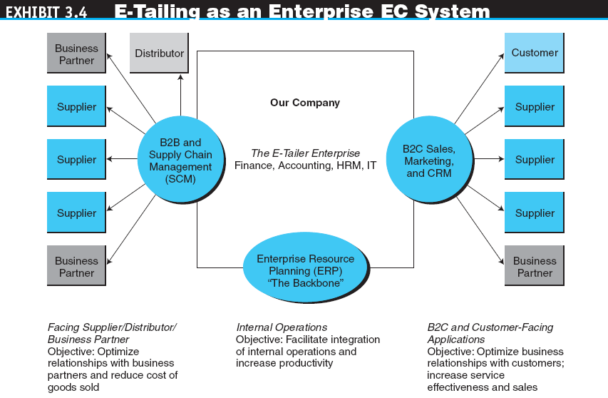

Slide 10
INTERNET MARKETING AND ELECTRONIC RETAILING
CHARACTERISTICS AND ADVANTAGES OF SUCCESSFUL E-TAILING
Sound business thinking, visionary leadership, thorough competitive analysis and financial analysis, and the articulation of a well-thought-out EC strategy are essential.
Ensure appropriate infrastructure, particularly a stable and scalable technology infrastructure to support the online and physical aspects of EC business operations.

Slide 11
E-TAILING BUSINESS MODELS
5 CLASSIFICATIONS OF MODELS BY DISTRIBUTION CHANNEL
Direct marketing by mail-order retailers that go online
Direct marketing by manufacturers
Pure-play (virtual) e-tailers
Click-and-mortar retailers
Internet (online) malls

Slide 12
E-TAILING BUSINESS MODELS
direct marketing
Broadly, marketing that takes place without intermediaries between manufacturers and buyers; in the context of this book, marketing done online between any seller and buyer.
direct marketing by Manufacturers
virtual (pure-play) e-tailers
Firms that sell directly to consumers over the Internet without maintaining a physical sales channel.

Slide 13
E-TAILING BUSINESS MODELS
click-and-mortar retailers
Brick-and-mortar retailers that offer a transactional Web site from which to conduct business.
brick-and-mortar retailers
Retailers who do business in the non-Internet, physical world in traditional brick-and-mortar stores.
Multi-channel business model
A business model where a company sells in multiple marketing channels simultaneously (e.g., both physical and online stores).

Slide 14
E-TAILING BUSINESS MODELS
Retailing in Online Malls
Referring Directories
Malls with Shared Services (e.g. taobao’s tmall)
OTHER B2C MODELS AND SPECIAL RETAILING
Online Group Buying
B2C IN SOCIAL NETWORKS
Virtual Shopping in 3D

Slide 15
TRAVEL AND TOURISM (HOSPITALITY) SERVICES ONLINE
Extra SERVICES PROVIDED
Travel tips, fare tracking, email alerts, online driving maps
SPECIAL SERVICES ONLINE (e.g. lastminute.com)
Wireless services or mobile check-in
Direct marketing
Alliances and consortia
Travel-Oriented Social Networks (e.g. wikitravel.org or wayn.com (where are you now))

Slide 16
TRAVEL AND TOURISM (HOSPITALITY) SERVICES ONLINE
BENEFITS OF ONLINE TRAVEL SERVICES
Free information
Accessible at any time from any place
Substantial discounts
LIMITATIONS OF ONLINE TRAVEL SERVICES
Many people do not use the Internet
The amount of time and the difficulty of using virtual travel agencies can be significant
Complex trips or those that require stopovers might not be available online
CORPORATE TRAVEL

Slide 17
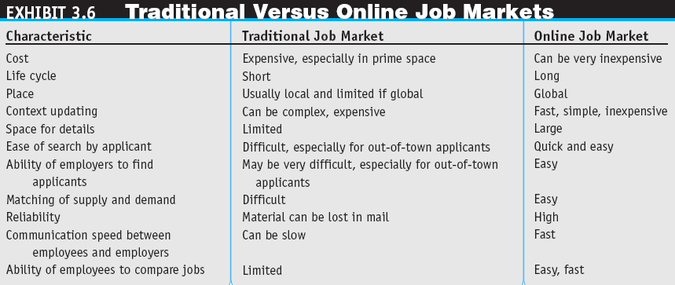

Slide 18
EMPLOYMENT PLACEMENT AND THE JOB MARKET ONLINE
Theses parties use the Internet job market:
Job seekers
Employers seeking employees
Classified ads
Job agencies
Government agencies and institutions
Online Job Markets on Social Networking
Global Online Portals

Slide 19
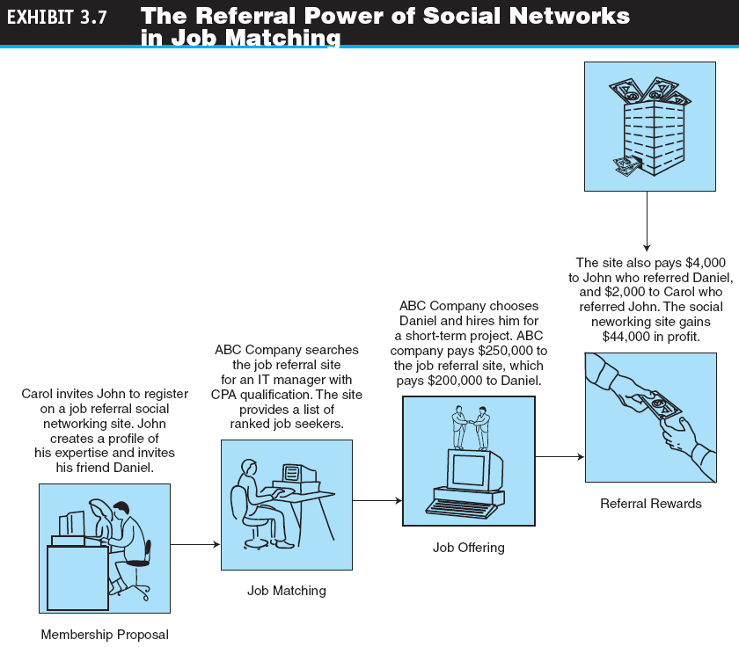

Slide 20
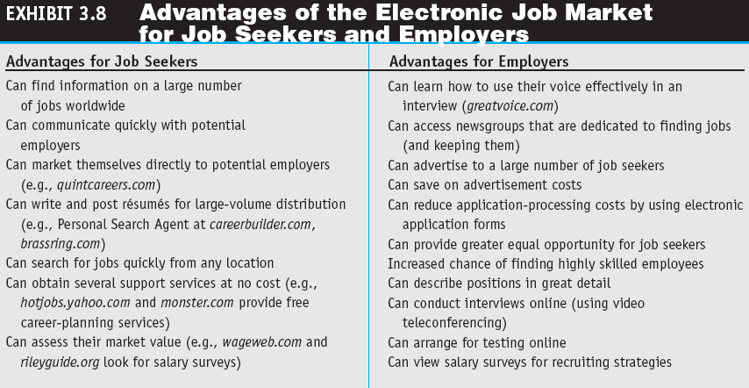

Slide 21
REAL ESTATE, INSURANCE, AND STOCK TRADING ONLINE
REAL ESTATE ONLINE
Zillow, Craigslist, and Other Web 2.0 Real Estate Services
INSURANCE ONLINE
ONLINE STOCK TRADING
The Risk of Trading in an Online Stock Account

Slide 22
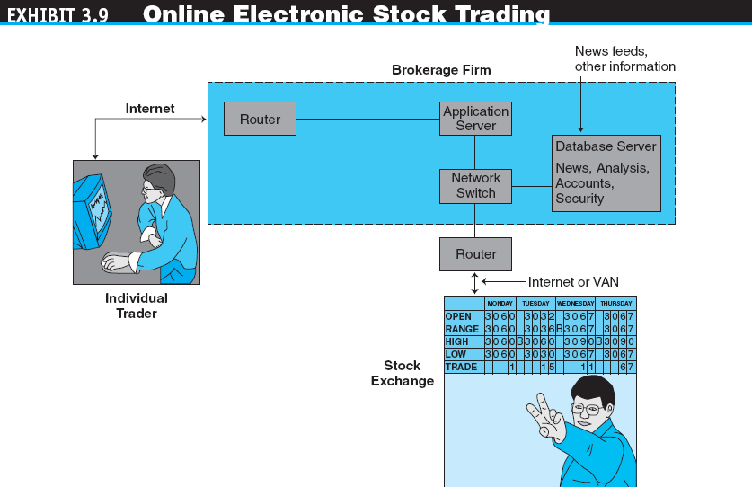

Slide 23
BANKING AND PERSONAL FINANCE ONLINE
electronic (online) banking or
e-banking
Various banking activities conducted from home or the road using an Internet connection; also known as cyberbanking, virtual banking, online banking, and home banking.

Slide 24
BANKING AND PERSONAL FINANCE ONLINE
HOME BANKING CAPABILITIES
VIRTUAL BANKS
INTERNATIONAL AND MULTIPLE-CURRENCY BANKING

Slide 25
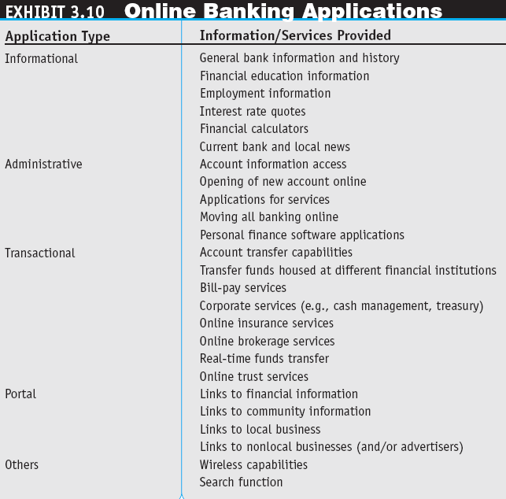

Slide 26
BANKING AND PERSONAL FINANCE ONLINE
ONLINE FINANCIAL TRANSACTION IMPLEMENTATION ISSUES
Securing Financial Transactions
Imaging Systems
Fees Online Versus Fees for Offline Services
Risks
ONLINE BILLING AND BILL PAYING
Taxes

Slide 27
ON-DEMAND DELIVERY OF PRODUCTS, DIGITAL ITEMS, ENTERTAINMENT, AND GAMING
ON-DEMAND DELIVERY OF PRODUCTS
e-grocer
A grocer that takes orders online and provides deliveries on a daily or other regular schedule or within a very short period of time.
on-demand delivery service
Express delivery made fairly quickly after an online order is received.

Slide 28
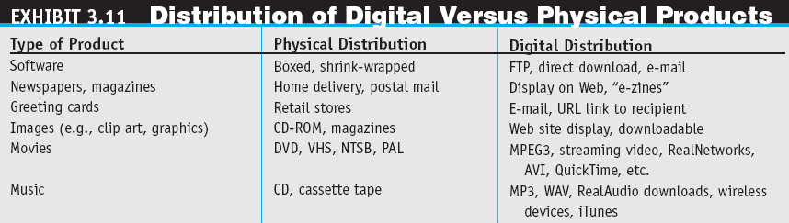

Slide 29
ON-DEMAND DELIVERY OF PRODUCTS, DIGITAL ITEMS, ENTERTAINMENT, AND GAMING
ONLINE ENTERTAINMENT
Adult Entertainment
Internet Gaming
Online Dating Services

Slide 30
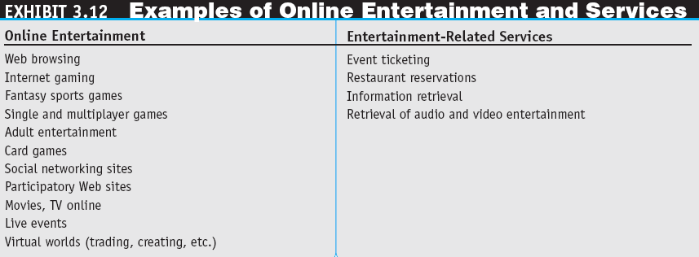

Slide 31
ONLINE PURCHASE-DECISION AIDS
shopping portals
Gateways to e-storefronts and
e-malls; may be comprehensive or niche oriented.

Slide 32
ONLINE PURCHASE-DECISION AIDS
shopping robots (shopping agents or shopbots)
Tools that scout the Web on behalf of consumers who specify search criteria.
''Spy'' Services
Wireless Shopping Comparisons

Slide 33
ONLINE PURCHASE-DECISION AIDS
BUSINESS RATINGS SITES (e.g. alexa.com)
TRUST VERIFICATION SITES (e.g. verisign.com, truste.com, secureassure.com)
Recommendations from Other Shoppers and Friends
referral economy
The effect upon sales of consumers receiving a referral or recommendation from other consumers.
OTHER SHOPPING TOOLS

Slide 34
ISSUES IN E-TAILING AND LESSONS LEARNED
disintermediation
The removal of organizations or business process layers responsible for certain intermediary steps in a given supply chain.
reintermediation
The process whereby intermediaries (either new ones or those that had been disintermediated) take on new intermediary roles.

Slide 35
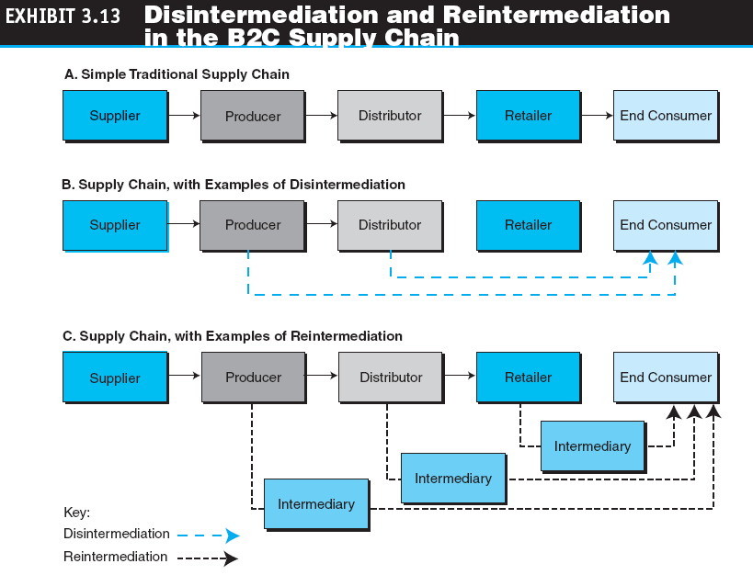

Slide 36
ISSUES IN E-TAILING AND LESSONS LEARNED
channel conflict
Situation in which an online marketing channel upsets the traditional channels due to real or perceived damage from competition.
DETERMINING THE RIGHT PRICE
PRODUCT AND SERVICE CUSTOMIZATION AND PERSONALIZATION
FRAUD AND OTHER ILLEGAL ACTIVITIES

Slide 37
ISSUES IN E-TAILING AND LESSONS LEARNED
LESSONS LEARNED FROM FAILURES AND LACK OF SUCCESS
Speak with one voice
Leverage the multi-channels
Empower the customer

Slide 38
MANAGERIAL ISSUES
What are the limitations of
e-tailing?
How should we introduce wireless shopping?
Do we have ethics and privacy guidelines?
How will intermediaries act in cyberspace?
Should we try to capitalize on social networks?

